Slide 1
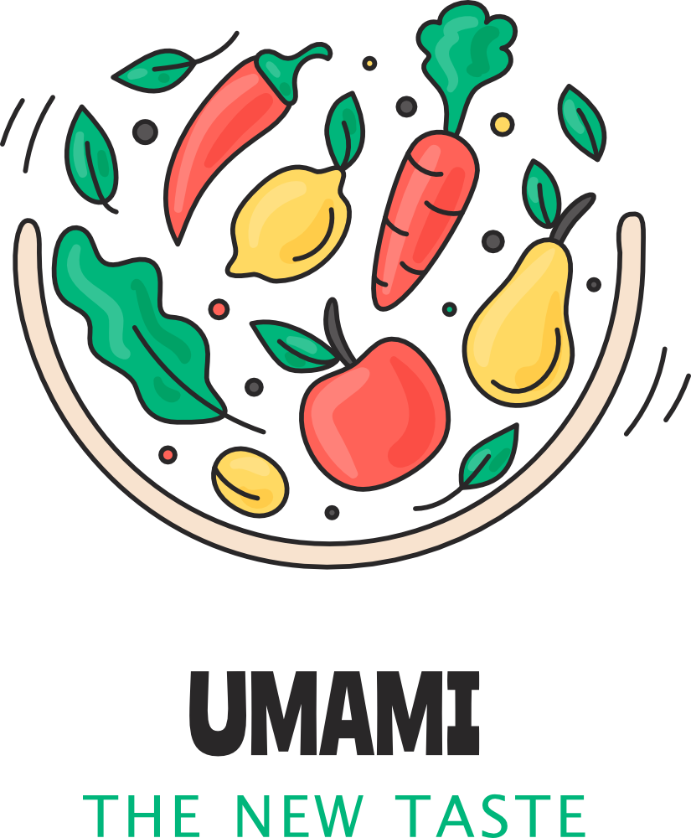
TEAM
404 Food Not Found
Nadezhda Semenova
Yassine Belloum
Dmytro Volkov
Notes:
Yassine last sentence: UMAMI uses advanced machine learning and computer vision to help users make safer and healthier food choices, celebrating global culinary diversity.

Slide 2
Purpose and Relevance
Allergen Awareness: Enhances food safety with allergen detection.
Nutritional Insights: Empowers healthier choices with nutritional details.
Culinary Diversity: Discovering dishes from worldwide cuisines.
Global Trends: Promotes mindful eating through informed choices.
Notes:
yassine last sentence: By merging technology, food safety, and healthier living, UMAMI goes beyond simple image recognition.
Beyond recognition, UMAMI serves an important purpose: providing essential allergen information and promoting informed eating.
For individuals with dietary restrictions, it offers peace of mind and confidence when making food choices in social or unfamiliar settings. UMAMI also supports healthier decisions through nutritional insights and helps users discover dishes from global cuisines.

Slide 3
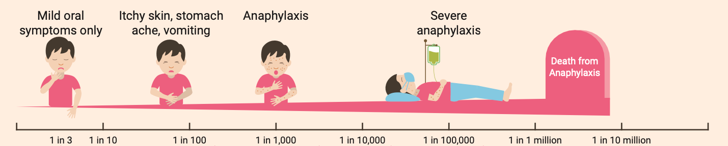
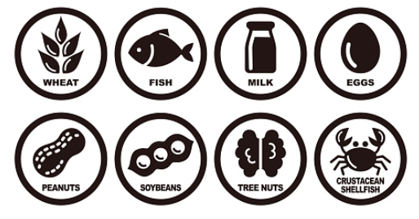
Food Allergies: Risks and Realities
Complex Allergens: One food can contain multiple allergens.
Multiple Sensitivities: People may be allergic to several foods.
Notes:
yassine last sentence: UMAMI helps mitigate these risks by providing clear allergen information, making food choices safer.
The reason we focus on allergens in our project is their significant impact on millions of people worldwide, as they can be life-threatening and require careful attention.

Slide 4
Steps in Implementation
Build a binary food/non-food classifier.
Extend classification to 101 food categories.
Scale to 251 fine-grained food categories.
Dataset | Categories | Images
Food5K | 2 | 5 000
Food-101 | 101 | 101 000
Food-251X | 251 | 120 000
Notes:
Yassine last sentence: Here we aim to fine-tune and refine our model to accommodate an even greater diversity of dishes.

Slide 5
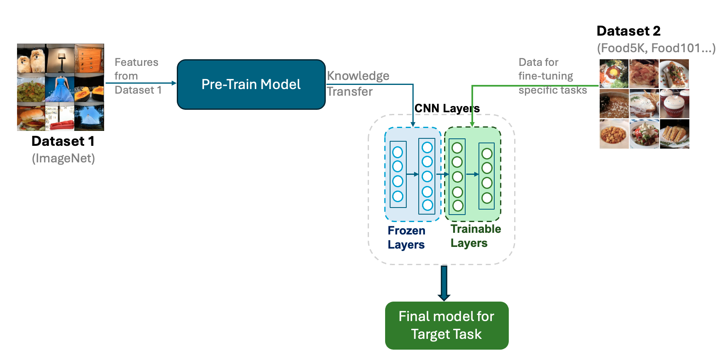
Transfer Learning Workflow for Image Classification
Notes:
yassine last sentence This approach effectively maximizes the potential of existing knowledge while optimizing results for our specific application."

Slide 6
Top Pre-Trained Image Classification Models
Model | Number of parameters (x 10⁶) | Depth | Max. accuracy (%) | FLOPs (x 10⁹)
EfficientNetB0 | 5.3 | 235 | 77.3 | 0.39
ResNet50 | 25.6 | 50 | 76.2 | 4.1
VGG16 | 138 | 16 | 71.5 | 15.3
FLOPs: the number of FLoating-point OPerations
Notes:
Nadine
There are many pre-trained models for computer vision, each suited for different tasks. We compared three popular models and selected ResNet50 for binary classification due to its balance of accuracy and efficiency. For multi-class classification, we chose EfficientNetB0 for its high accuracy and low computational cost.
· Number of parameters (x10⁶): Indicates the complexity of the model in terms of learnable weights.
· Depth: The number of layers, which reflects the capacity of the model to extract features.
· Max. accuracy (%): The highest classification accuracy achieved on datasets.
· FLOPs (x10⁹): A measure of computational cost in floating-point operations.

Slide 7
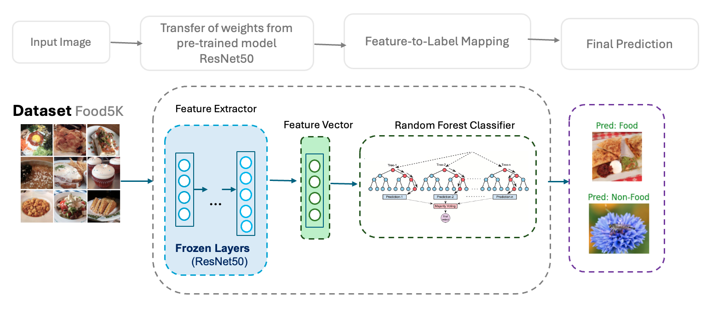
Baseline Model: Binary Classification
Notes:
Nadine
Food classification is challenging due to the large number of categories. To simplify, we started with a binary classification model to determine whether an image shows food or non-food.
The baseline model architecture combines transfer learning with ResNet50 for feature extraction and a Random Forest classifier for final prediction. ResNet50, pre-trained on ImageNet, extracts key features from images and converts them into a feature vector. This vector is passed to the Random Forest classifier, which predicts whether the image is food or non-food. Our model achieves 98% overall accuracy on the test dataset.

Slide 8
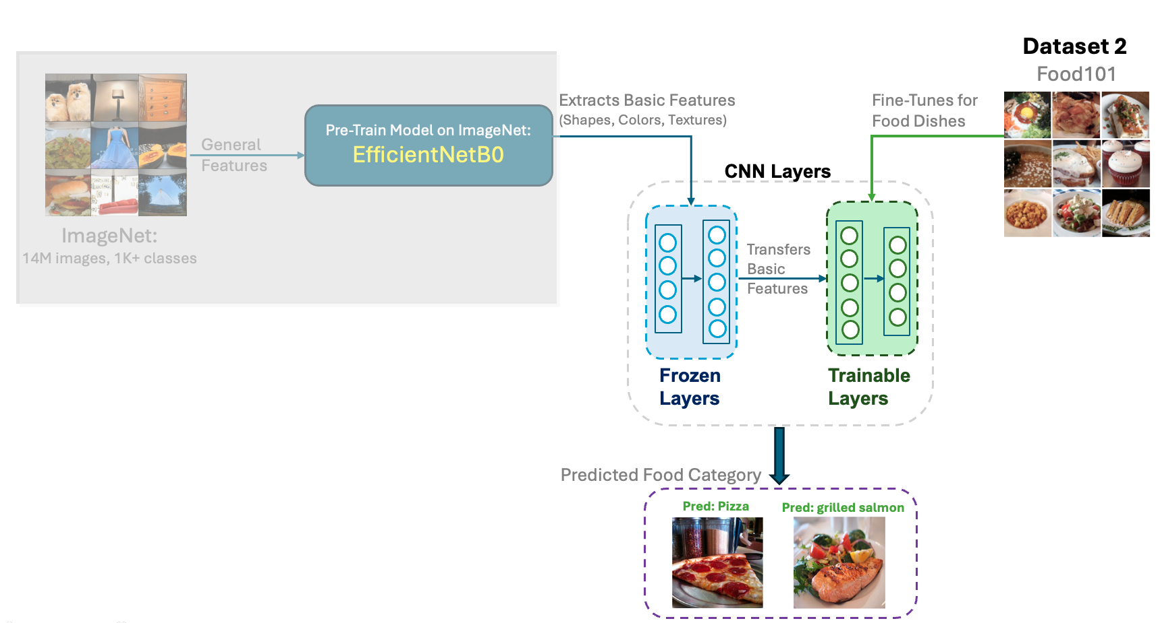
Multi-class model
Notes:
Nadine
The next step in our pipeline is multi-class food image classification. We used EfficientNetB0, keeping its initial layers frozen to retain general knowledge.
In addition, we added trainable layers, which were fine-tuned using a food-specific dataset to help the model recognize details unique to different dishes.
With this approach, our model achieved 75% accuracy.

Slide 9
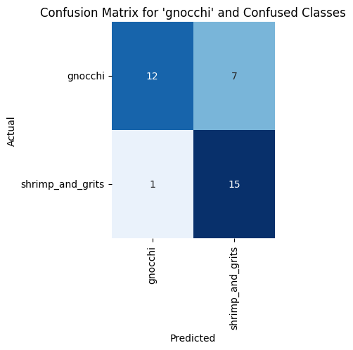
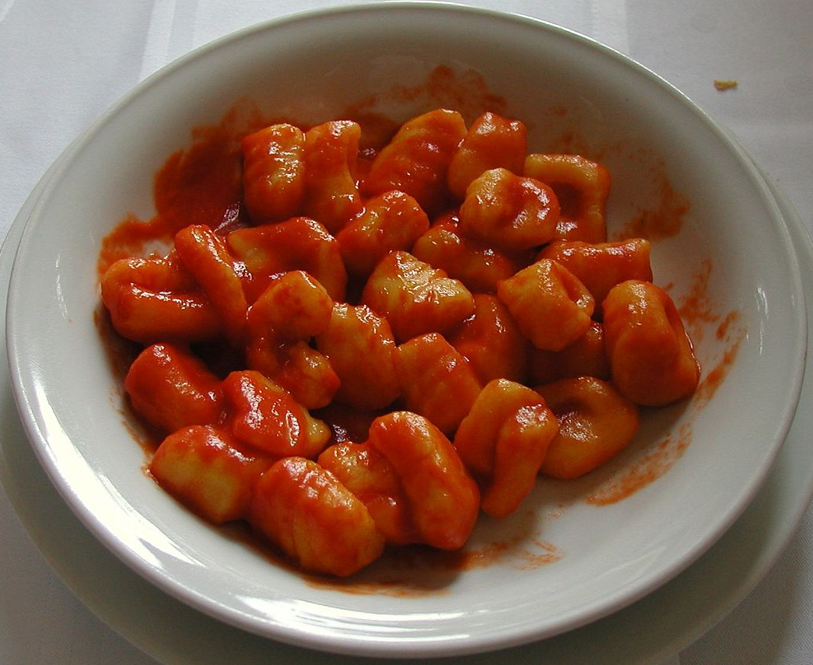
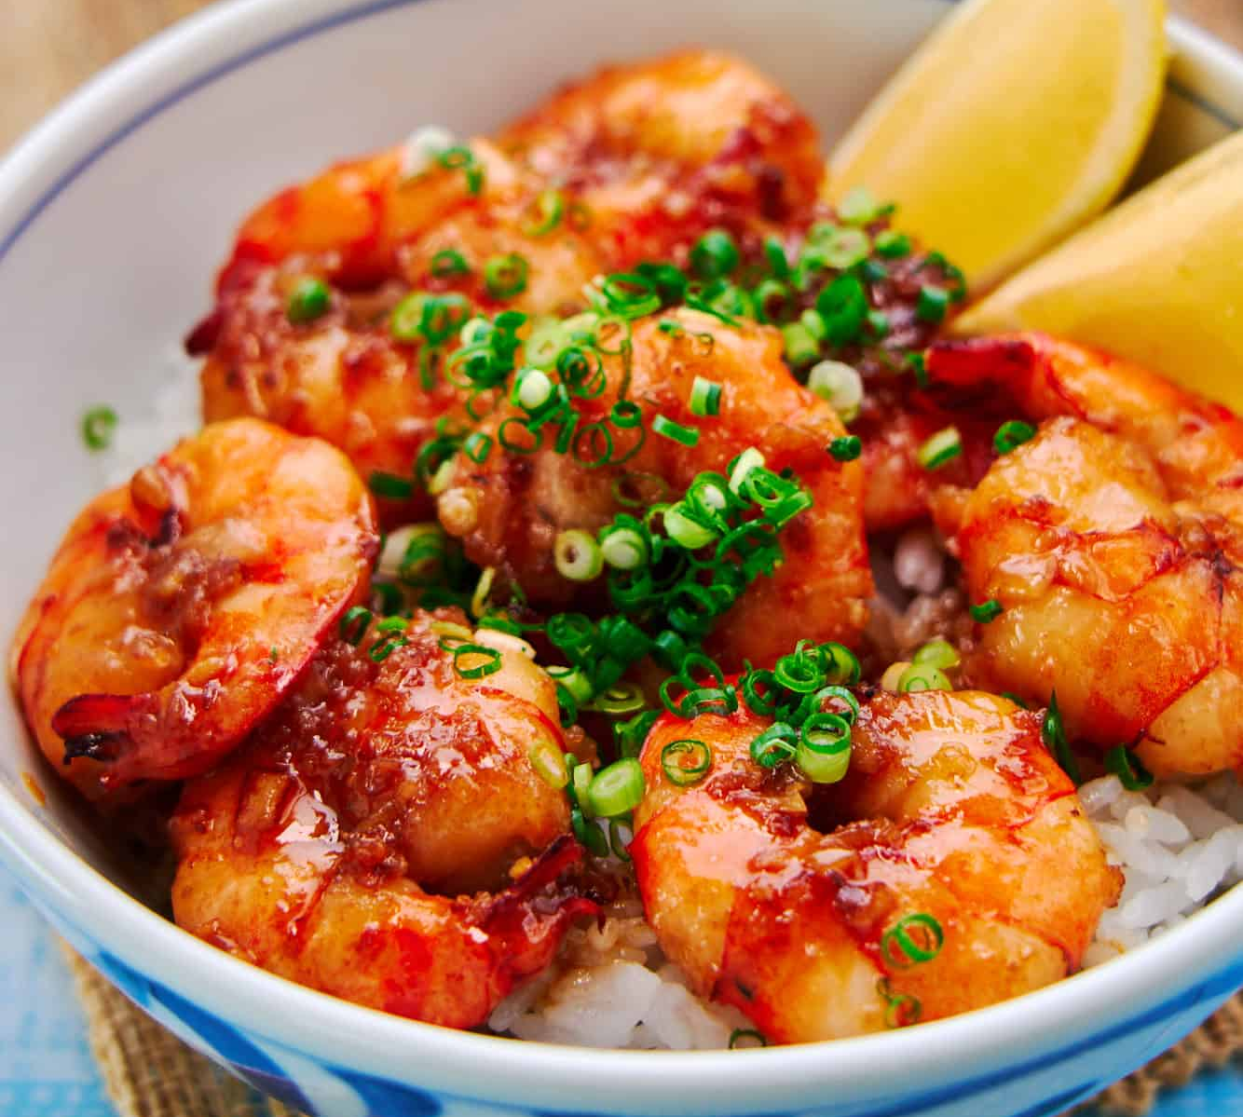
Challenges in Multi-Class Classification
Gnocchi
Shrimp
Notes:
Nadine:
However, accuracy alone does not tell the full story. One of the key challenges our model faces is visually similar dishes, which often share overlapping features like shapes, colors, and textures. Variations in preparation and presentation make the task even harder.
The Confusion Matrix on the right highlights a specific challenge with gnocchi and shrimp classes. The numbers show how the predicted labels align with the actual ones, and the model often misclassifies gnocchi as shrimp. As the images demonstrate, even humans might find it difficult to distinguish these dishes by appearance, which explains the challenge for the model.

Slide 10
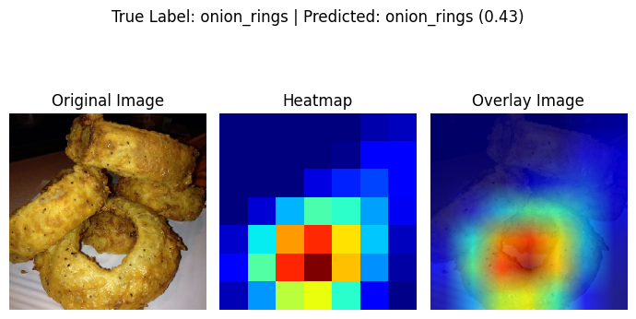
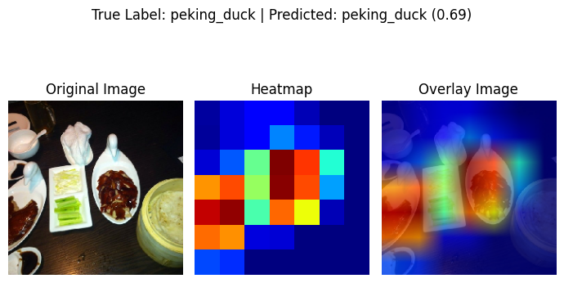
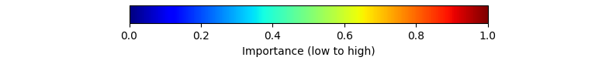
Interpreting Predictions with GradCAM
Heatmap Color Scale
Notes:
Nadine:
To better understand how the model makes decisions, we used GradCAM to generate heatmaps, which highlights areas most important to the model's predictions.
In the heatmaps Red areas indicate regions with the highest importance for the prediction and Blue one with the least.
For example, in the "onion rings" image, the model focused mainly on the rings themselves (highlighted in red), ignoring the background. This indicates that the model is learning to focus on relevant parts of the image during classification.
Such visualizations help not only verify the accuracy of predictions but also provide insights for further improvements.

Slide 11








Tools Behind UMAMI
Machine Learning
Data Analysis
Deployment
Computer Vision
Grad-CAM
Project repo: https://github.com/YassBe/UMAMI
Notes:
Nadine:
These are the tools that helped us create UMAMI.
And now, to give you a better understanding of how our application works, I’ll hand it over to Dima for a live demo.

Slide 12
DEMONSTRATION
Notes:
(SIDEBAR) As you heard earlier from Yassine and Nadine, our project aimed to provide information service based on image analysis. To do that we provide several means of image upload to the users.
(SIDEBAR - EXAMPLES) For instance, they may want to simply try out the app. If so, there are several examples provided for them to see what kind of service it provides.
(SIDEBAR - LOAD AND PHOTO) If they would decide do upload their own image or make a photo and apply our algorithm to it - we have provided them with such options as well. We also provided here some options and functions.
But let’s see and example.
(APPLEPIE) After uploading the image, the user can use the prediction algorithm and see the results. Our algorithm works in the way that it applies several layers/models one after another. The more complex and heavy multi-class model (I’d call it layer 2) is deployed only if the binary classification model (layer 1) is predicting a FOOD class (unless option Force GradCam is triggered). (TEXT BLOCK UNDER THE IMAGES) From the general useful information perspective, we provided the user with a brief (emoji depicting) origin of the food (class), that the model predicted to have the highest model certainty score. The higher the score - the more certain the model is in its prediction.
(GRADCAM) - OPTION TO FORCE, MODEL SELECTOR
(ALLERGENS, DIETARY CLASS) As Yassine already said, we would like to pay extra attention to some other categories of information, that we believe would be important and useful for our users. Namely, ALLERGENS and animal origin content. As you can guess, there are as many versions of the same dish, as there are cooks in the world. Thus, we decide to include allergens, based on WHAT ALLERGENS MAY BE THERE - it is way easier to ask a chef whether there is a specific allergen or not THAN GOT TO A HOSPITAL. The same principle with some deviations applies to - the animal origin content (Vegetarian and Vegan food)
(CONTENT AND NUTRITION!) Let’s move on the the next block. In the first tab we provide the list of BASE INGREDIENTS, as well as VARIATIONAL INGREDIENTS - region specific. We believe that it would be useful in various ways. Let’s say I saw/made a photo of a meal, that I’d like to make myself. I got to this tab and look what ingredients I have and what I need to get in the groceries. There are many more use cases, but let’s move to the next tab.
(NUTRITION - PIE CHART!!!!!!!!!!!!!!!!!!!!!!!!!!) Here we provide some information on the content and calories to those, who pay attention to it. For now, we would like to provide only the calories per 100g of the meal and the corresponding proteins, fats and other carbohydrates content (incl. sugars).
(OTHER OPTIONS WITH LOWER PROBABILITIES) And finally, other probable variants of the prediction. Our models are not perfect, and we do assume errors would happen. Hence, we provide users with other four probable predictions, which have lower certainty (probability) scores. This way, our users, in case of an error (or of a low certainty score for the main prediction) will see what other classes of food our model considered to be probable.
And now I’d briefly demonstrate several use case and example made myself yesterday during the midnight lunch. This one is made on a phone,

Slide 13

https://goracij.duckdns.org:8501/

